Slide 1
Welcome to the
Minnesota SharePoint
User Group
November 11th, 2009
SharePoint 2010 - Overview
Wes Preston
Raymond Mitchell
http://www.sharepointmn.com
Meeting #60

Slide 2
Today’s Event Agenda
 | Lake Of the Woods - 1 | Lake Of the Woods - 2
9:00 - 9:15 | Intro
9:15 - 10:30 | SharePoint 2010 Overview: A Walk Around the Wheel
10:30-- 10:40 | Break
10:40 - 12:15 | SharePoint 2010 Overview: A Walk Around the Wheel, cont.
12:15 - 1:00 | Lunch & Learn: Preparing for SharePoint 2010
1:30 - 2:45 | SharePoint 2010 for Business Users Office 2010 Client Apps and SharePoint 2010 | SharePoint 2010 Development
3:00 - 4:15 | SharePoint 2010 for Business Users Access Services | SharePoint 2010 Administration
4:30 – Later | "SharePint" at Major's in Bloomington
http://www.sharepointmn.com

Slide 3
Session Agenda
Introductions
Part 1
Break
Part 2
Q&A
http://www.sharepointmn.com

Slide 4
User Group Goal / Objectives
Develop and support a local community focused on Microsoft SharePoint Technologies
Educate user group members about SharePoint Technologies
Transfer knowledge within the community
Communicate best practices
Introduce new products / solutions
http://www.sharepointmn.com

Slide 5
Introductions – MNSPUG Sponsors
Inetium (www.inetium.com)
Technology consulting company
Microsoft Gold Certified Partner
Practice area focused on SharePoint
New Horizons – Minnesota (www.newhorizonsmn.com)
Microsoft Gold Certified Partner
Training on many technologies
Microsoft (www.microsoft.com)
http://www.sharepointmn.com

Slide 6
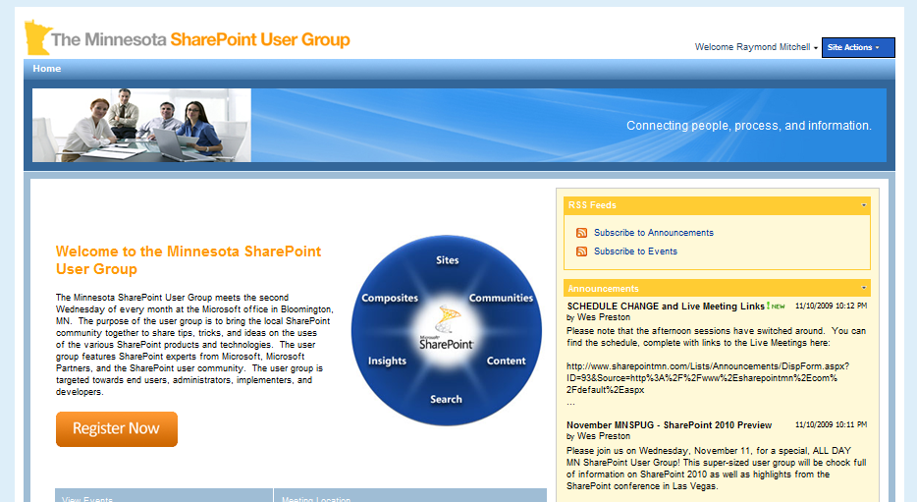
www.sharepointmn.com
Website for user group
SharePoint resource documents
SharePoint resource links
RSS Feeds
Meeting Schedule
Past User Group Presentations
www.sharepointmn.com
http://www.sharepointmn.com

Slide 7
Upcoming Schedule
Next Meeting
December 9th 9:00 AM to 11:30 AM
Microsoft’s Bloomington Office
Topic: SharePoint 2010 - Migration
Check www.sharepointmn.com for updates!
Ongoing Schedule
2nd Wednesday of every month
9:00 to 11:30 am
Microsoft’s Bloomington Office
http://www.sharepointmn.com

Slide 8
Conferences
ANY? SharePoint Conference 2009 – October 19-22, 2009 http://www.mssharepointconference.com Las Vegas, NV
Local Events
Minneapolis Office Developer Interest Group – November 12, 2009 5:30 PM SharePoint 2010 – Client Object Model
http://www.sharepointmn.com/MODIG
SharePoint Server 2007 – Workflow and Digital Forms – November 19, 2009 http://www.nhmn.com Edina, MN
http://www.sharepointmn.com

Slide 9
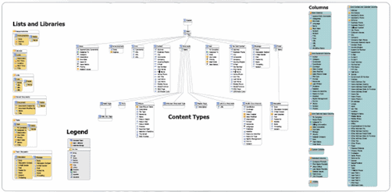
Thanks!
Mark from EUSP.com shared SharePoint 2010 Team Site Posters
http://www.endusersharepoint.com/
http://www.sharepointmn.com

Slide 10
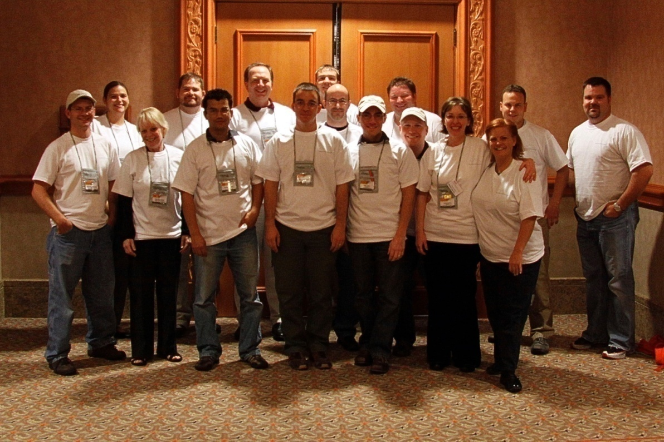
SPC09
Tons of great content
Friends of the MNSPUG got together for a photo:
http://www.sharepointmn.com

Slide 11
Announcements
Public Beta 2 available later this month!
Register for it here: http://sharepoint2010.microsoft.com/try-it/Pages/Trial.aspx
Get Ready!
SharePoint Server 2010 will be 64-bit only.
SharePoint Server 2010 will require 64-bit Windows Server 2008 or 64-bit Windows Server 2008 R2.
SharePoint Server 2010 will require 64-bit SQL Server 2008 or 64-bit SQL Server 2005.
http://blogs.msdn.com/sharepoint/archive/2009/05/11/announcing-sharepoint-server-2010-preliminary-system-requirements.aspx
http://www.sharepointmn.com

Slide 12

Veterans Day
Thank you
http://www.sharepointmn.com

Slide 13

SharePoint 2010 - Overview
http://www.sharepointmn.com

Slide 14
*Disclaimer*
All of the information gathered and presented today is based on versions of the software prior to final release.
Features and functionality *may still change* before the RTM versions are available.
Many of the slides and graphics presented today are based on content released and presented at SPC 09.
http://www.sharepointmn.com

Slide 15














Microsoft SharePoint 2010 The Business Collaboration Platform for the Enterprise and the Web
Sites
Composites
Communities
Connect and Empower People
Cut Costs with a Unified Infrastructure
Insights
Content
Rapidly Respond to Business Needs
Search
http://www.sharepointmn.com

Slide 16
SharePoint 2010 Timeline
Summer 2009 Early previews given to partners
Early Fall 2009 First public disclosure at #SPC09
November 2009 PUBLIC BETA: “Beta 2”
…
Q2-ish 2010 Estimated RTM
http://www.sharepointmn.com

Slide 17
Before we get into the wheel….
There’s this thing called “SharePoint”
Only its not that simple…
http://www.sharepointmn.com

Slide 18
“SharePoint”
SharePoint Team Services
SharePoint Portal Server 2001
Windows SharePoint Services 2.0
Microsoft SharePoint Portal Server 2003
Windows SharePoint Services 3.0
Microsoft Office SharePoint Server 2007
http://www.sharepointmn.com

Slide 19


And now in 2010:
http://www.sharepointmn.com

Slide 20
But it is more complicated than that…
http://www.sharepointmn.com

Slide 21








Intranet
Internet/Extranet
Enterprise Client Access License (CAL) Standard Client Access License (CAL)
New
High-End Search
New
New
New
Enabling Technologies

Slide 22



Internet/Extranet
 | Create Rich Sites for Customers and Partners Using All of SharePoint’s Capabilities For organizations looking to create customer-facing public internet sites or private extranets This is our premier internet site edition, with full SharePoint Enterprise functionality
 | Build Small-Scale Internet Sites on the SharePoint Platform For small and mid-size organizations looking to create customer-facing public internet sites or basic extranets using the Standard features of SharePoint Server 2010 Note that this edition will have performance/scale limits
New in 2010

Slide 23



Microsoft Enterprise Search
 | Powerful High-end Search Delivered Through SharePoint Search is strategic Want high-end capabilities and easy deployment and manageability Are building custom search solutions and integrated applications
 | Complete Intranet Search Solution Want enterprise-class intranet search with low touch from IT Scalable, searches LOB systems, improved people search
 | Departmental Search Have tactical, low scale search applications (such as departmental sites) Want quick, basic projects requiring little or no cost and IT effort
(Requires SharePoint Server 2010
and SharePoint Enterprise CAL)

Slide 24

SharePoint-The Core of a Web Strategy
Intranet
Extranet
Internet
Core Audiences
Intranet
Internal employees
Extranet
Customers
Partners
Internet
External web users
Notes:
2007’s big innovation was making Internet possible
2010 allows you to do all of this on premise or in the cloud

Slide 25


SharePoint Online
Intranet
Internet/Extranet
New
Enterprise User Subscription License (USL)
Standard User Subscription License (USL)
Deskless User Subscription License (USL)
New
Internet Sites Offer
Partner Access Offer
New
Moving towards parity between on-premises and online
Parity in features and scenarios enabled
Introducing: Enterprise USL, Internet Sites, and Partner Access offers

Slide 26

Where did “Office” go?
Office has been dropped from the product name – NOT from the story.
Continued “Better Together” story for Office Client and SharePoint
Additional investment in server versions of Office Client Applications (Visio, Access)
Office Clients available in the web browser:
“Office Web Apps”
http://www.sharepointmn.com

Slide 27
Building Solutions with SharePoint
Out of the box functionality
SharePoint Designer
Visual Studio
“Services”
Forms
Excel
Access
Visio
Bar showing OOB, SPD, VS – how there is more of each, + services, etc…
http://www.sharepointmn.com

Slide 28
2010 is a BIG release
SharePoint Server 2010
SharePoint Foundation 2010
Microsoft Office SharePoint Server 2007
WSS V3.0
SharePoint Portal Server 2003
WSS V2.0
SharePoint Portal Server 2001
Team Services
http://www.sharepointmn.com

Slide 29
SharePoint Core Features
Sites
Lists / Libraries
Web Parts
Pages
Alerts
Versioning
Metadata
Workflow
Security
Sites
Composites
Communities
Insights
Content
Search

Slide 30
SharePoint Foundation 2010
Business Connectivity Services
External Lists
Workflow
SharePoint Designer
Visual Studio
API Enhancements
REST/ATOM/RSS
Ribbon UI
SharePoint Workspace
SharePoint Mobile
Office Client
Office Web App Integration
Standards Support
Sites
Composites
Communities
Blogs and Wikis
Insights
Content
Search

Slide 31
SharePoint Server 2010
Business Connectivity Services
InfoPath Form Services
External Lists
Workflow
SharePoint Designer
Visual Studio
API Enhancements
REST/ATOM/RSS
Ribbon UI
SharePoint Workspace
SharePoint Mobile
Office Client
Office Web App Integration
Standards Support
Sites
Composites
Communities
Tagging, Tag Cloud, Ratings
Social Bookmarking
Blogs and Wikis
My Sites
Activity Feeds
Profiles and Expertise
Org Browser
PerformancePoint Services
Excel Services
Chart Web Part
Visio Services
Web Analytics
SQL Server Integration
PowerPivot
Insights
Content
Search
Enterprise Content Types
Metadata and Navigation
Document Sets
Multi-stage Disposition
Audio and Video Content Types
Remote Blob Storage
List Enhancements
Social Relevance
Phonetic Search
Navigation
FAST Integration
Enhanced Pipeline

Slide 32
Sites
http://www.sharepointmn.com

Slide 33
What are Sites?
The basic capabilities required to use SharePoint sites to engage employees, partners and customers in an effective manner, both inside and outside the firewall
On the old wheel: Part of the core Platform Services

Slide 34

SharePoint Sites
Easy site editing, including theming & branding
Office Ribbon UI for faster training & adoption
Rich offline experience with SharePoint Workspace
Rich User Experience
Anywhere Access
Mobile-based interaction with people and content
Read-write web access using Office Web Application
Cross-browser support for maximized participation
Single Platform
Collaboration across Intranet, Extranet & Internet
Improved interoperability with standards support
Out-of-box accessibility compliance for WCAG 2.0

Slide 35
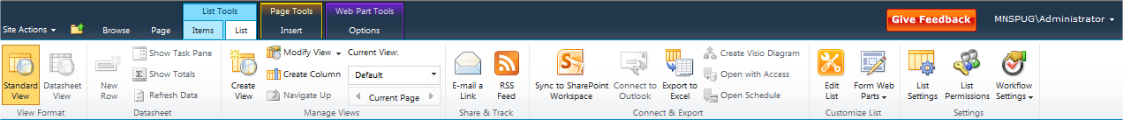
Ribbon
Formerly in Word, Access, Excel, PowerPoint
Context aware menus
Now available in SharePoint:

Slide 36
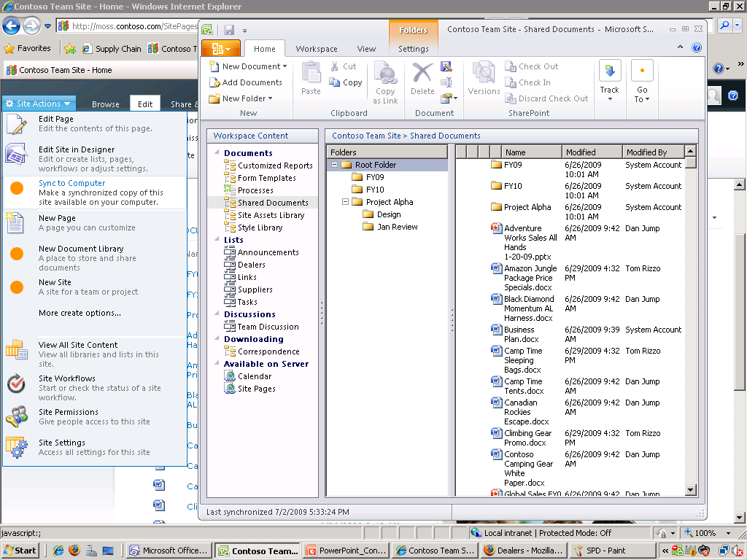
Workspace
Take lists, libraries, and files offline
Syncs differences
Formerly Groove:
Notes:
SharePoint’s New Groove (I’m not saying it) -RM

Slide 37

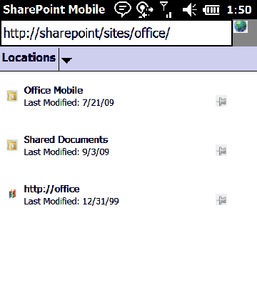
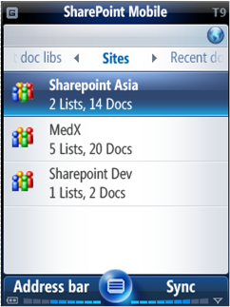
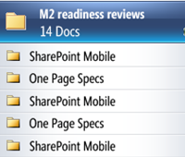
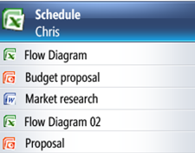
Mobile
Native Client for Windows Mobile devices
Mobile SDK for developing custom mobile experiences
SharePoint
Workspace Mobile
Access multiple sites and libraries
View and sync libraries easily
Access your content offline

Slide 38
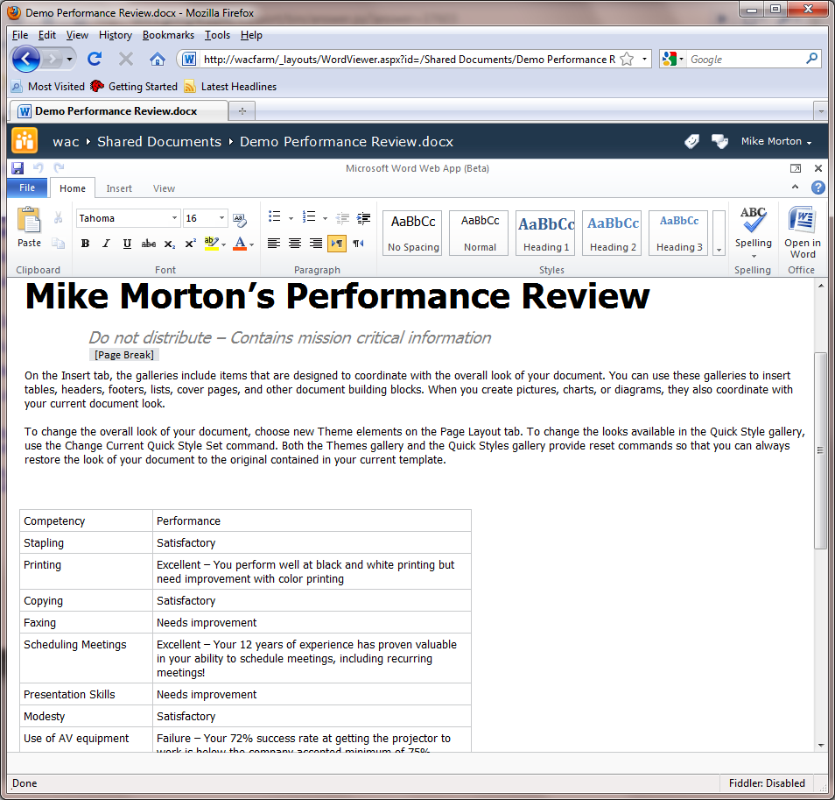
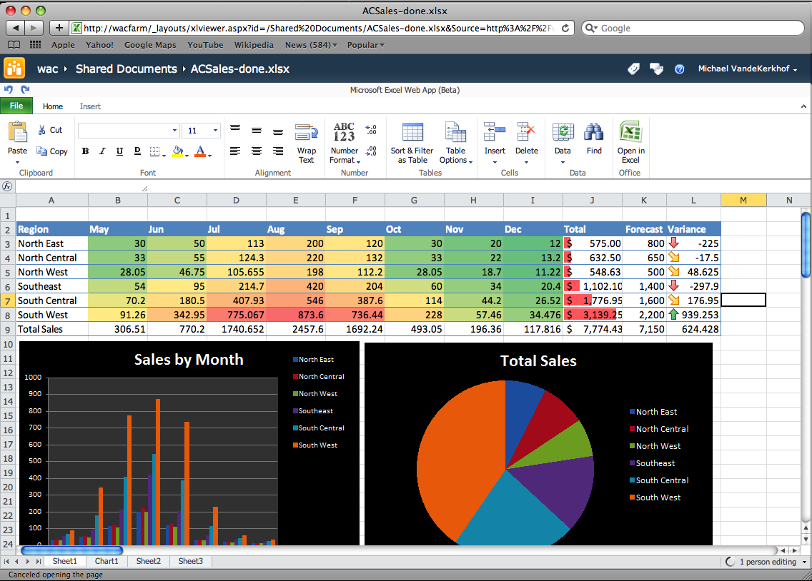
Office Web Application
Rich experience in the browser
Supports co-authoring of Office Client Documents
Cross Browser Support

Slide 39
Demos/Screenshots
Ribbon UI
Site Editing
Silverlight Web Part
Theming

Slide 40
Communities
http://www.sharepointmn.com

Slide 41
What are Communities?
The ability to easily access expertise and interact with other people in new and creative ways across the enterprise through both formal and informal networks
On the old wheel: Formally known as Collaboration

Slide 42
SharePoint Communities
Promote sharing with easy social authoring
Easily navigate resources with pervasive tagging
Find better answers faster via user feedback
Informal Knowledge
Social Connections
Connecting users through enhanced profiles
Staying up-to-date using news feeds and alerts
Make expertise discovery easy across the enterprise
Participation Anywhere
Work with peers whether online or offline
Collaborate on the go through the mobile UI
Enrich existing applications with social context

Slide 43
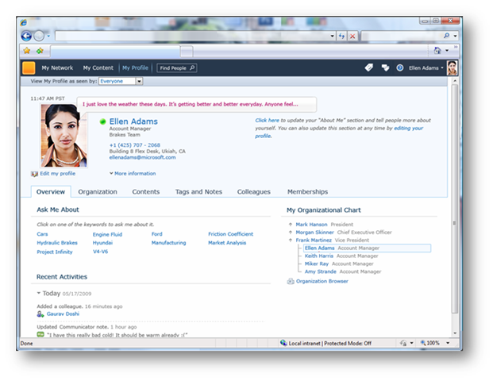
My Sites & Profiles
Enhanced!
Status Updates
Org Chart
Activity Feeds
Tags & Notes

Slide 44
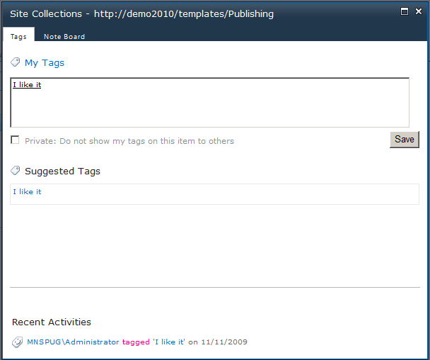
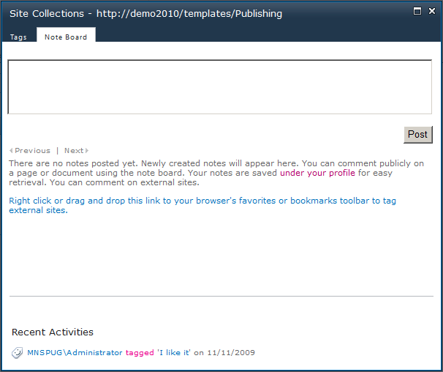
Tags, Notes & Ratings
New!
Tag items with keywords
Rate list items
Note Board

Slide 45
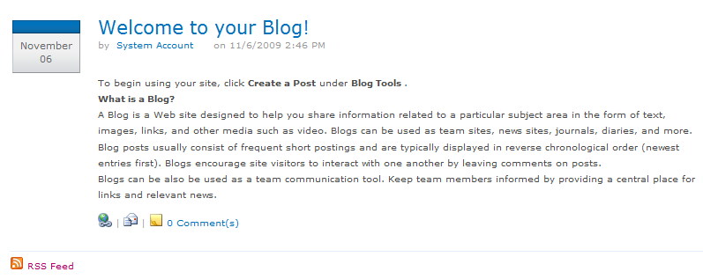
Blogs & Wikis
Improved!
What you’d expect from a blog
Better navigation for Wikis

Slide 46
Demos/Screenshots
Tagging
Ratings
Blogging
Enterprise Wikis

Slide 47
Content
http://www.sharepointmn.com

Slide 48
What is Content?
The facilities for the creation, review, publication and disposal of content including conforming to defined compliance rules, whether the content exists as traditional documents or as Web pages. SharePoint 2010’s content-management capabilities include document management, records management, and Web-content management.
On the old wheel: Formally known as Content Management

Slide 49
SharePoint Content
Intuitive interaction with content through Office
Fast discovery using content metadata and tagging
Rapid creation and publishing of web content
User-centric
Flexibility and Compliance
Pervasive records management and legal holds
Enterprise-wide taxonomies and folksonomies
Cross-farm policies and rules for all content types
Management Efficiency
Metadata and tagging managed by same services
Less storage and bandwidth for Office & binary content
Interoperability framework to link legacy repositories

Slide 50
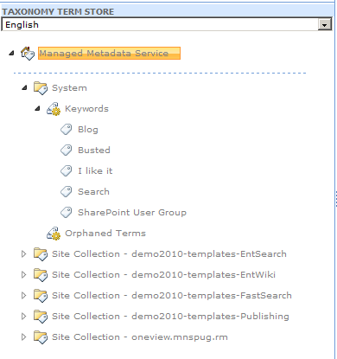
Metadata
Centrally defined taxonomy/terms:
Now available across site collections:
Content Types
Site Columns
Unique Document IDs
Metadata Navigation

Slide 51
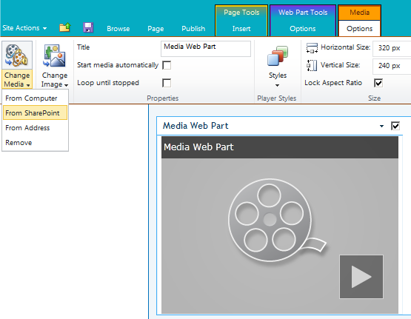
Video Streaming
New Media Web Part
Easily add video/audio
Upload or find content instead of copy & pasting URLs

Slide 52
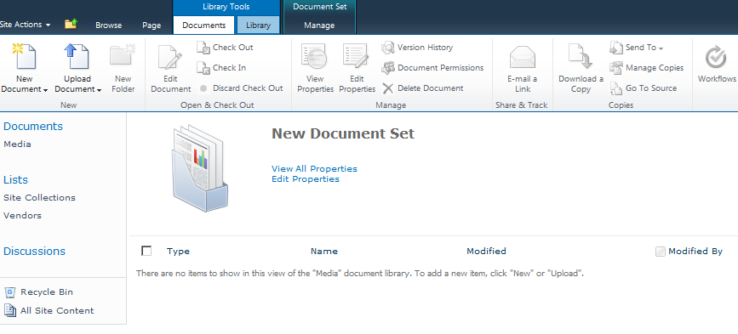
Document Sets
Manage multiple documents at once
Can be managed as a content type

Slide 53
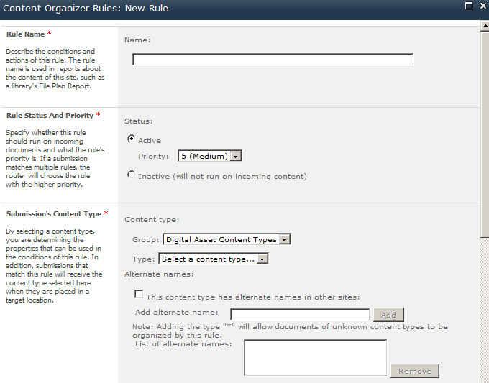
Document Routing
Available after activating site feature
Supports renaming and moving of content based on content type/properties
Rule-based routing:

Slide 54
Demos/Screenshots
Cross fingers

Slide 55
Search
http://www.sharepointmn.com

Slide 56
What is Search?
With more content existing online and multiple people collaborating on such content, it is critical that people can quickly and easily locate relevant content across SharePoint lists, sites and external systems and data sources, such as: file shares, Web sites or line-of-business applications.
On the old wheel: Also known as Search

Slide 57
SharePoint Search
Improved relevance based on usage and history
Rich results-navigators for shorter search time
Support for 400+ content types and 85 languages
Better Answers, Faster
Knowledge Amplification
Phonetic and multi-lingual for global relevance
Social connections driven by interests and expertise
Secure access to content, whether internal or external
Enterprise Deployment
Improved scale to meet any demand volume
Deployment-specific tuning for best results
Search-driven applications to enrich platform

Slide 58
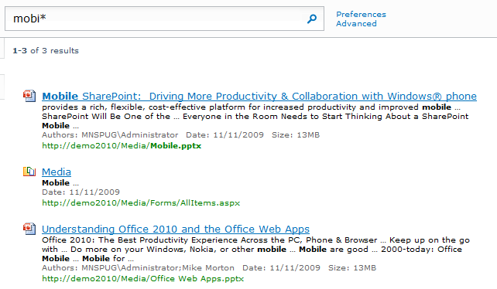
Wildcard Searching
Wildcard
Wildcard
*.wildcard
It is about time.
Notes:
They say it works... I’m not convinced?

Slide 59
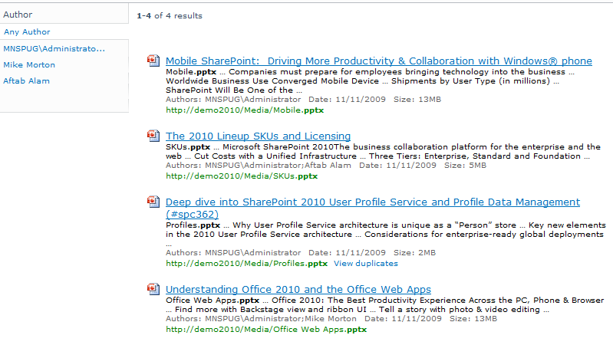
Improved Search Results
Search Result Refinement (AKA: facetted search)
Related Searches
Previews / Thumbnails (with FAST)
Sort on Social Distance

Slide 60
Demos/Screenshots
…?

Slide 61
Insights
http://www.sharepointmn.com

Slide 62
What are Insights?
Information workers need the ability to not only rapidly deliver and share information that is critical to the success of the business but also to turn raw data into actionable conclusions and to drive business results through sharing data-driven analysis.
On the old wheel: Business Intelligence

Slide 63
SharePoint Insights
Advanced analysis with Excel Services
Richer data visualization and easy sharing
Incorporation of LOB data in data analysis
Data interaction
Decision Making
Powerful Self-Service capabilities and visualizations
Compelling dashboards to drive business results
Rich reports with access to millions of rows
Organizational Effectiveness
Drive accountability and alignment with scorecards
Identify issues and opportunities with real-time access
Improved API for richer extensibility and development

Slide 64
Lots of new toys
Access Services
Visio Services
PowerPivot
Performance Point
Chart Web Part
Business Connectivity Services
The New BDC
Two-way updates!

Slide 65
Demos/Screenshots
Business Connectivity Services
Chart Web Part

Slide 66
Composites
http://www.sharepointmn.com

Slide 67
What are Composites?
Business users of all roles need the ability to quickly create customized solutions without involving corporate IT in each request. At the same time, the IT staff needs the capability to empower business users to create these applications while ensuring the environment’s stability and availability.
On the old wheel: Portals

Slide 68
SharePoint Composites
Enhanced toolset for end-user solutions
Process automation and data validation with Forms
Visio services integration for data visualization
User-Driven Solutions
Data Connectivity
Business Connectivity Services for LOB data exchange
LOB data in Outlook, Word & Workspace without code
SharePoint data exposed through web services & APIs
Solution Deployment
Sandboxed Solutions for self-service and fast installation
Platform stability with resource quota-management
Standards support for integration and accessibility

Slide 69
External Lists (and Office Client Integration)
Open BCS entities with Office Client Apps (ex: Outlook contacts)
Create with SharePoint Designer or Visual Studio

Slide 70
Sandbox Solutions
Upload SharePoint solutions to a site collection without server/farm admin rights!
Limited set of code access
Can be restricted and throttled by administrators

Slide 71
Demos/Screenshots
Workflow

Slide 72
SharePoint Server 2010
Business Connectivity Services
InfoPath Form Services
External Lists
Workflow
SharePoint Designer
Visual Studio
API Enhancements
REST/ATOM/RSS
Ribbon UI
SharePoint Workspace
SharePoint Mobile
Office Client
Office Web App Integration
Standards Support
Sites
Composites
Communities
Tagging, Tag Cloud, Ratings
Social Bookmarking
Blogs and Wikis
My Sites
Activity Feeds
Profiles and Expertise
Org Browser
PerformancePoint Services
Excel Services
Chart Web Part
Visio Services
Web Analytics
SQL Server Integration
PowerPivot
Insights
Content
Search
Enterprise Content Types
Metadata and Navigation
Document Sets
Multi-stage Disposition
Audio and Video Content Types
Remote Blob Storage
List Enhancements
Social Relevance
Phonetic Search
Navigation
FAST Integration
Enhanced Pipeline

Slide 73
IT Pro Investments
Terabytes of data and multi-million item lists
Improved Platform resiliency and redundancy
Advanced back-up, restore and disaster recovery
Scale with Governance
Deployment Flexibility
Collaboration across Intranet, Extranet and Internet
On-premise and/or hosted options
Data storage inside and outside the SharePoint DB
IT Productivity
Enterprise-wide management capabilities
Robust installation and predictable upgrade process
Higher availability with better patch management

Slide 74
Developer Investments
Rapidly develop solutions with Visual Studio 2010
Application Lifecycle Management & Team Dev
Solution quality improved with debugging tools
Developer Productivity
Deployment Platform
Rich solution UI with Silverlight, XSLT View, Clean HTML
Data Foundation – Relationships, Lookup
Better programmability with LINQ, Client API
Solution Hosting
Standardized WSP Package Deployment
SharePoint Online shared solution hosting
Install on Vista SP1 or Windows 7 for Developers only

Slide 75
Q & A
http://www.sharepointmn.com

Slide 76
References
Arpan Shaw’s SPC09 presentation…
SPC09 Beta book
http://mssharepointitpro.com
http://mssharepointdeveloper.com
http://sharepoint.microsoft.com

Slide 77

Thanks for coming!
Stick around for more sessions.
Come back for SharePint!
http://www.sharepointmn.com

